Slide 1
Microsoft AI Tour

Slide 2
Unlock Your Agents Potential with Model Context Protocol (MCP) L200

Slide 3

Speaker
Speaker name
Title
LinkedIn
linkedin.com/in/xx
GitHub
github.com/xx

Slide 4
Introduction
Setting the scene

Slide 5


Use case
You are a sales manager at Zava, a DIY retail company.
You need to analyze sales data to find trends, understand customer preferences and make informed business decisions.

Slide 6
Definition of agent
Agent
Semi-autonomous software that can be given a goal and will work to achieve that goal without you knowing in advance exactly how it's going to do that or what steps it's going to take.

Slide 7
How can MCP help us?

Slide 8

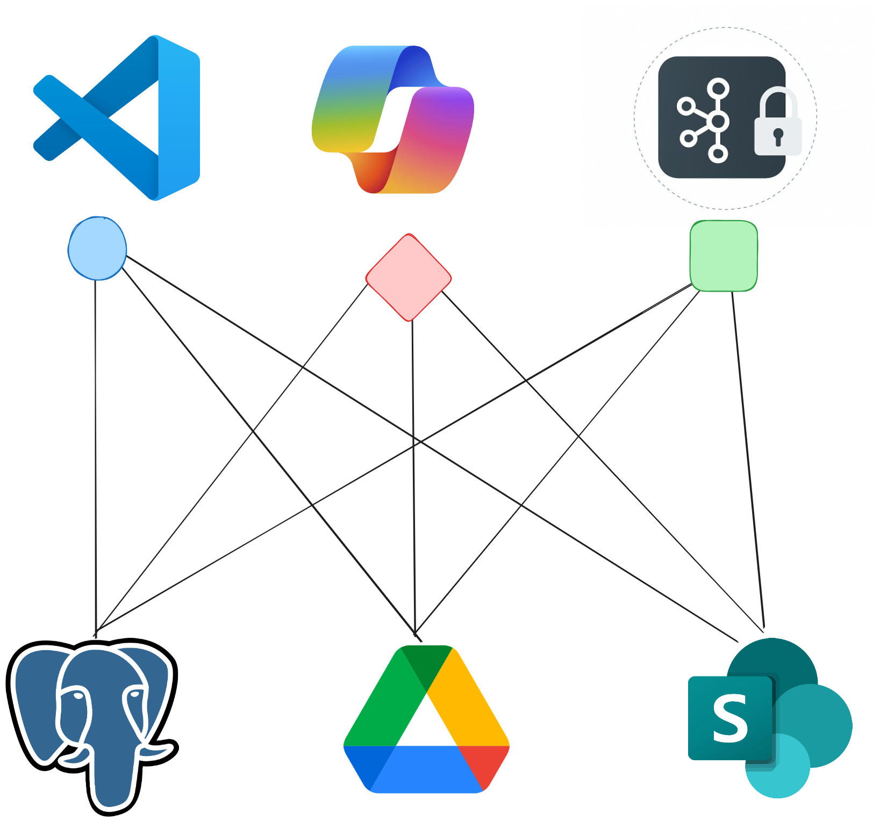
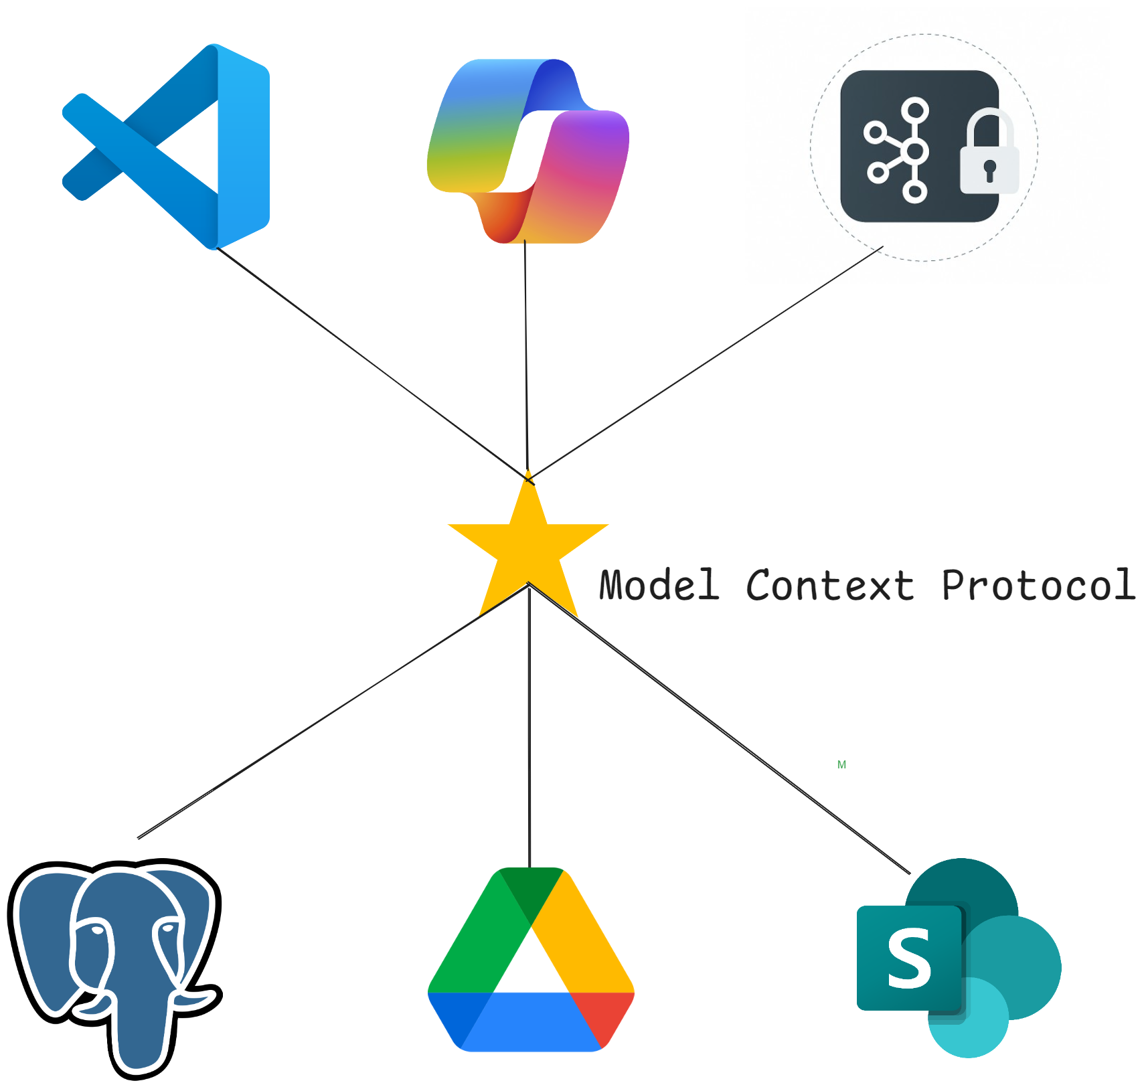




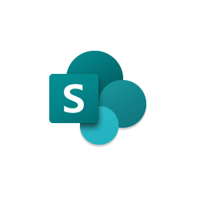
MCP simplifies tool access for LLMs
Model Context Protocol
LLM tools are integral to agent capability
Before MCP
integration chaos!!!
With MCP
simplified LLM tools

Slide 9
Definition of MCP
Model Context Protocol
MCP is an open protocol that standardizes how applications provide discovery, actions, and context to LLMs
It’s like USB-C but for AI
Enables business agility

Slide 10
What are we building?

Slide 11
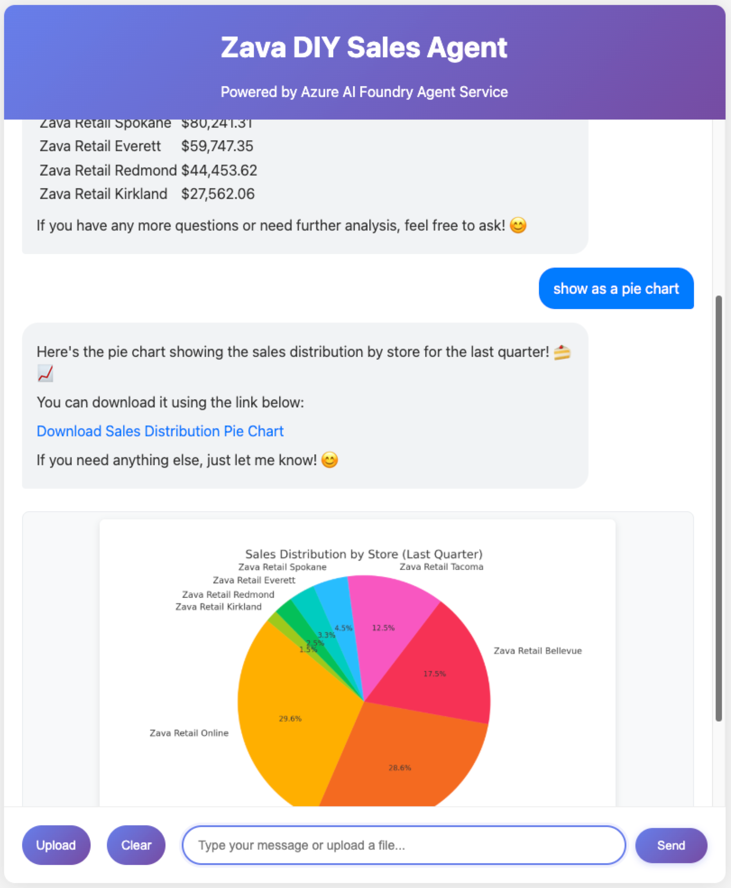
Zava Sales Agent
An agent built with Azure AI Agent Service, PostgresSQL and MCP
E2E Demo

Slide 12


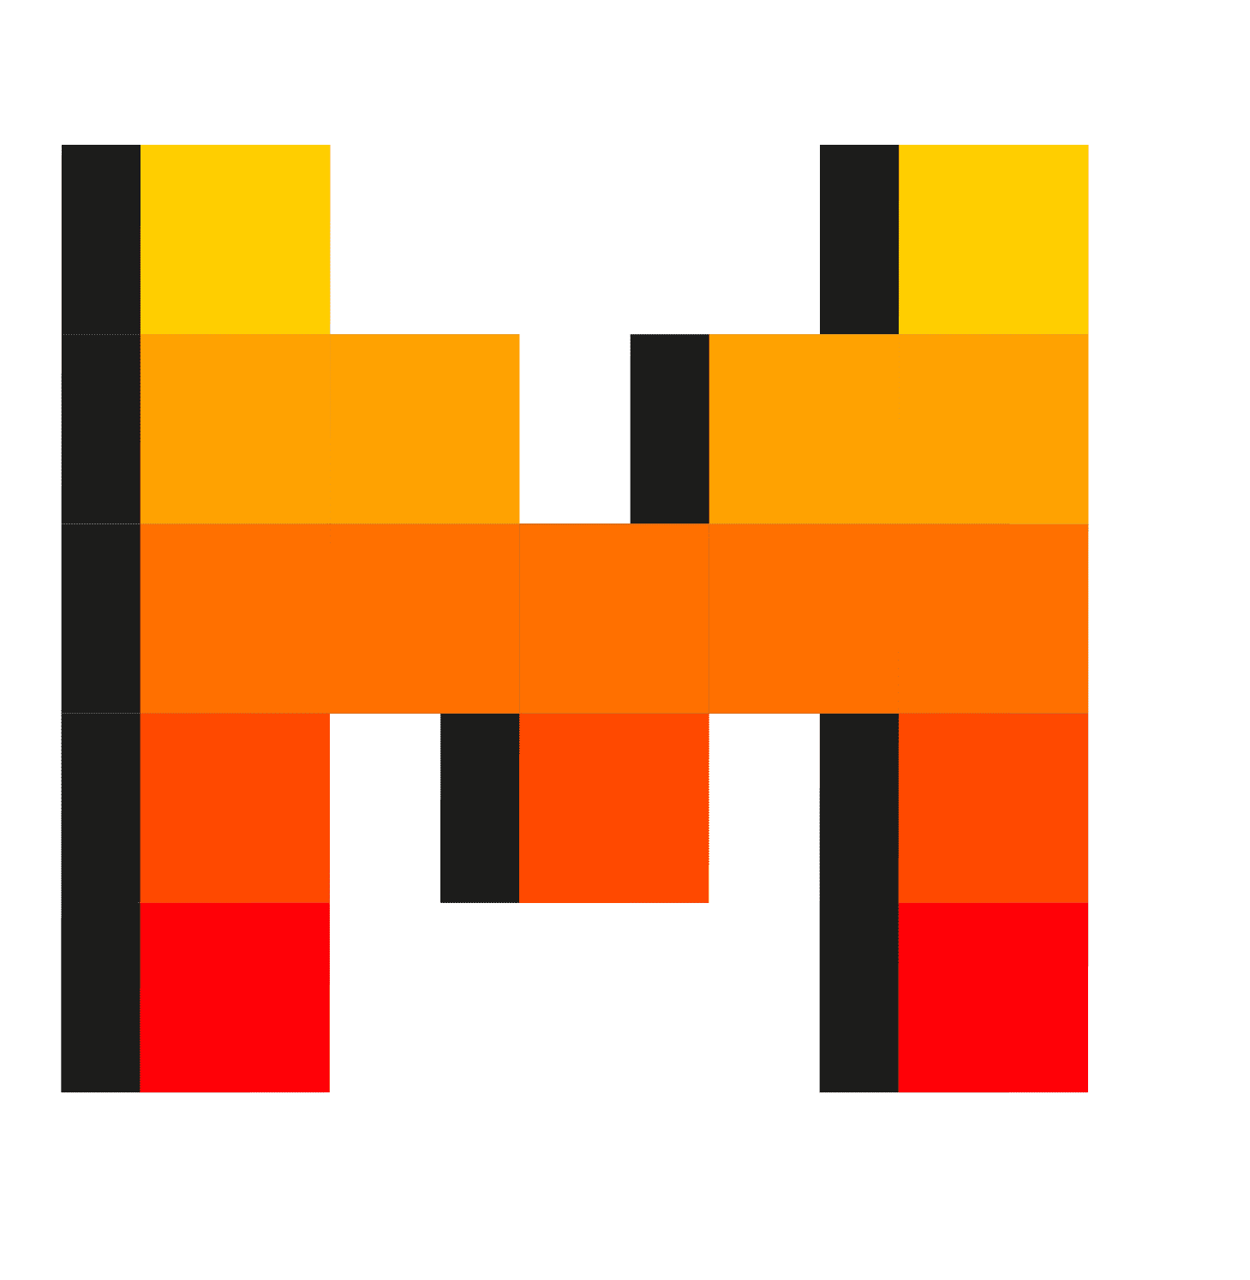



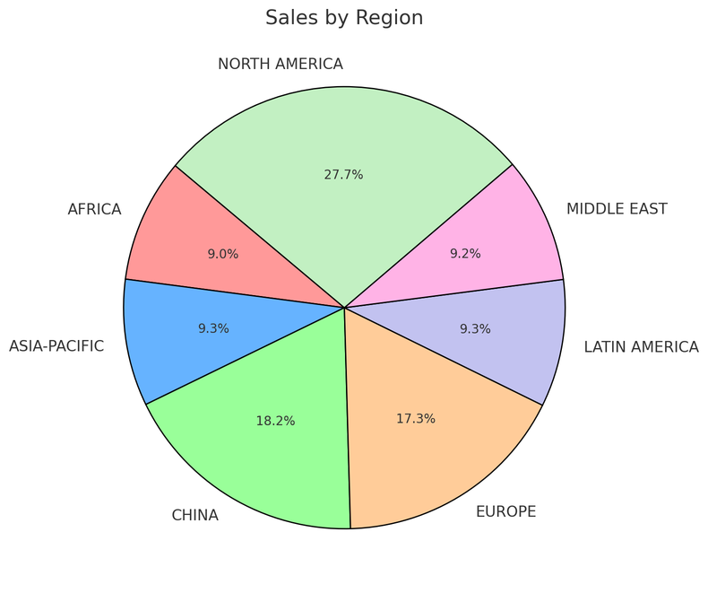
AI Agent Service in Action
Step 1:
Create an Agent
Step 2:
Create a Thread
Step 3:
Run the Agent
Step 5:
Check the Run status
Step 6:
Display the Agent’s Response
Agent
Sales Agent
Thread
Sales analysis
Instructions:
You are an advanced sales analysis agent for Zava, specializing in assisting users with sales data inquiries
Run 1
User’s message
Tell me the total sales by store
1
MCP Calling Tool
Query Postgres DB
Model
Agent’s message
Here is the sales:
Online: $15478.00
Seattle: $78792.00
2
Create message
Your data (optional)
Azure AI Search
Run 2
Files (local or Azure Blob)
User’s message
Show as a pie chart
1
Code Interpreter Tool
Create a pie chart
LLM Tools
MCP Servers
File Search
Code Interpreter
Function Calling
Bing Search
Microsoft SharePoint
Microsoft Fabric
Azure Logic Apps
Azure Functions
OpenAPI 3.0 specified tools
Agent’s message
2
Create message

Slide 13
Observability
In Azure AI Foundry this means:
Evaluators (e.g quality and safety)
Dashboards and Azure Monitor
Tracing
Observability ensures AI systems are reliable, safe and high-quality by enabling continuous monitoring and evaluation.

